Slide 1
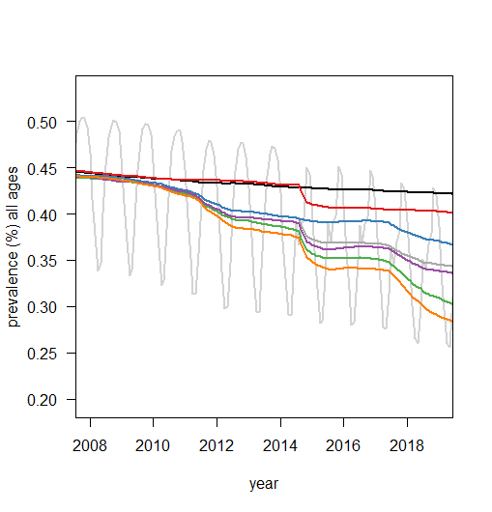
Figure 3. Predicted future impact in BF
"counterfactual_all_simulations.rds“ grey line is current situation yearly fluctuations which is summarised by the dark grey line (averaged over the year, which we use for all other runs to make more clear).
Scenario Year Estimated cases per 1000 people, per year
Baseline 2018
Current situation 2018
No bednets 2018
No SMC 2018
No pyrethroid resistance 2018
No outdoor biting 2018
No resistance or outdoor biting 2018
60%
50%
55%
70%
66%
82%

Slide 2
Figure 4. Predicted future impact in BF
Scenario Year Estimated cases per 1000 people, per year
Baseline 2000-3
Current situation 2020-3
stop bednets 2020-3
stop SMC 2020-3
pyrethroid-only LLINs 2020-3
pyrethroid-PBO 2020-3
perfect LLINs 2020-3
pyrethroid-only LLINs + IRS 2020-3
pyrethroid-only LLINs + IRS
perfect LLIN +IRS
60%
50%
55%
70%
66%
82%
82%
Bar colours could be same as lines on figure acting as key.

